Slide 1
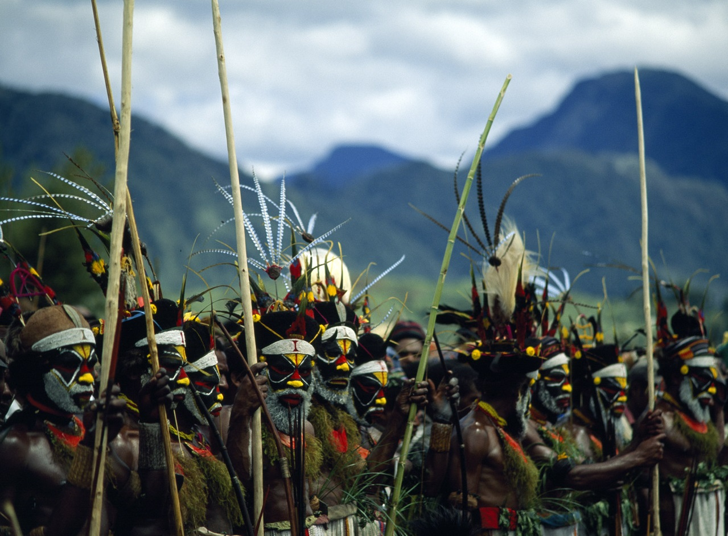
Guinea

Slide 2
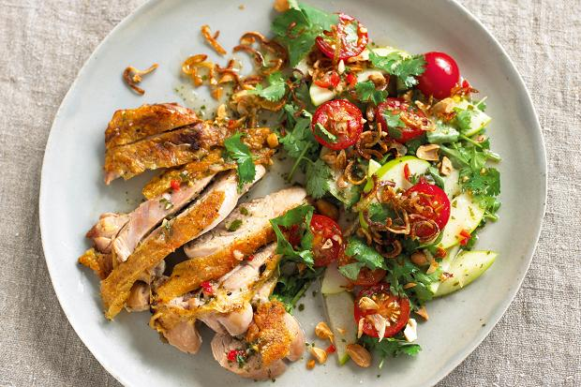
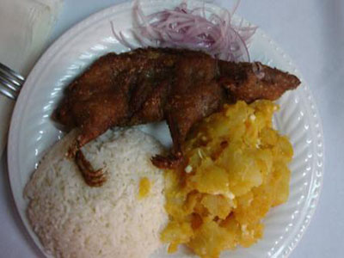
Food
What do poor people eat
What do wealthy people eat

Slide 3
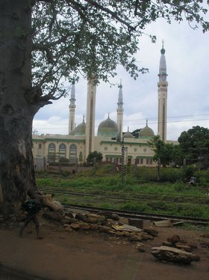
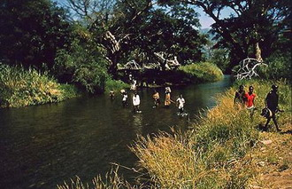
ATTRACTIONS OF GUINEA
Fouta Djallon plateau
Rue du Niger

