Slide 1
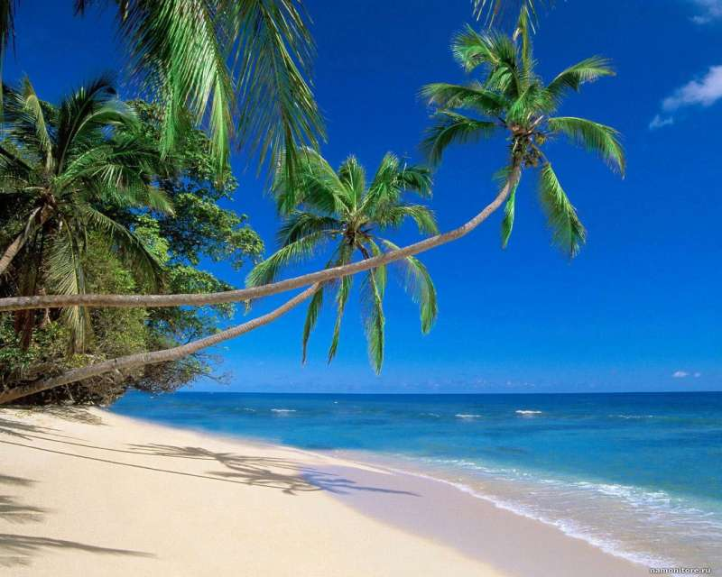
Caribbean islands. Cuba

Slide 2
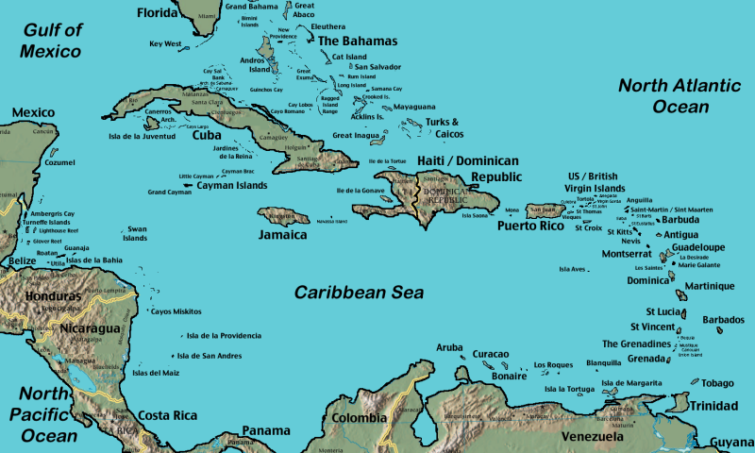
Caribbean islands (also called West-India) are a group of islands, which is situated between North America and South America and washed by Caribbean Sea, North Atlantic Ocean and Gulf of Mexico. The surface of all the islands is 244,890 km ².

Slide 3
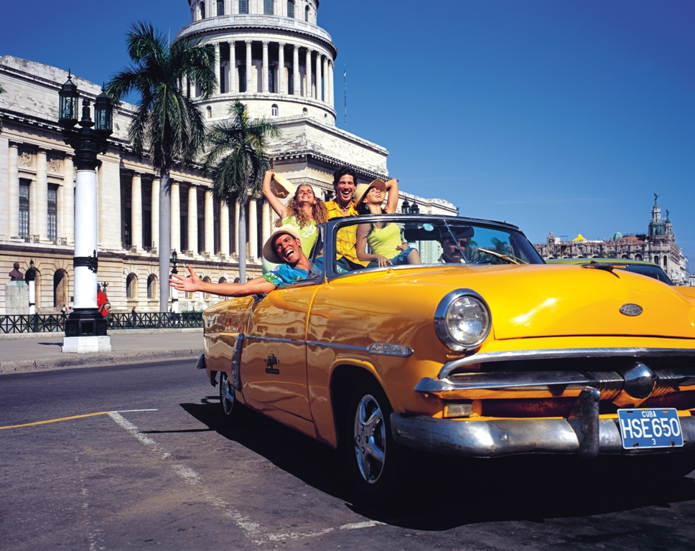
Republic of Cuba is situated on the Cuba island,which is the biggest of Caribbean islands. Unofficial name of this country is Island of liberty.

Slide 4
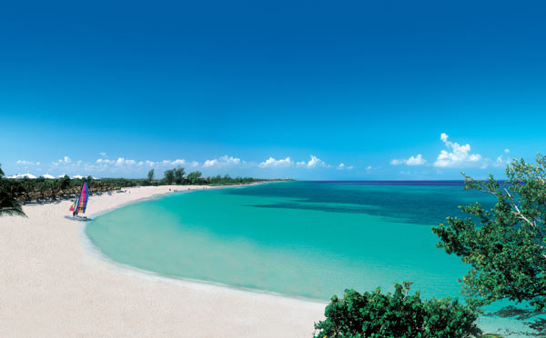
There are numerous gorgeous beaches, so tourism widely developed. The main resorts are Varadero, Holguin, Santa Maria del Mar.

Slide 5
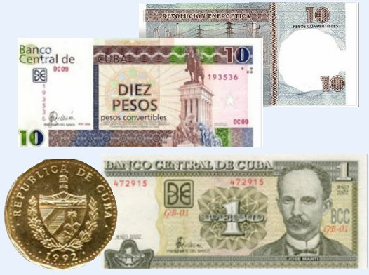
Cuban currency is peso.

Slide 6
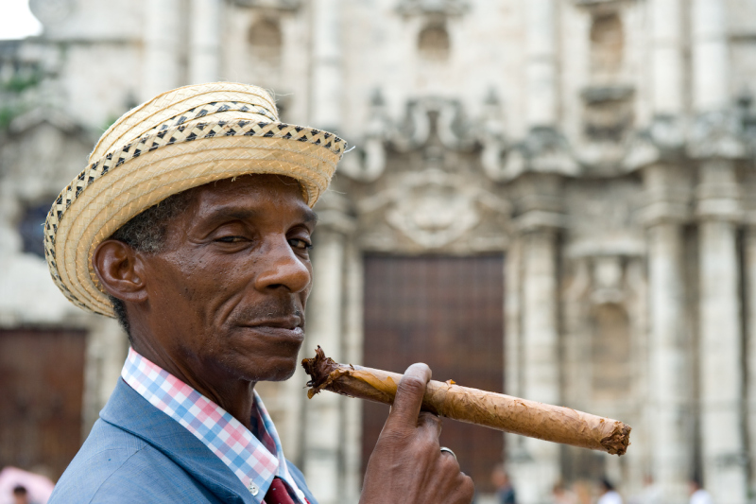
Cuban population is 11.4 million people. Cubans make up 95%. In turn, they are divided into Creole (descendants of Spaniards and other European settlers, approximately 65%), mulattos and blacks.

Slide 7
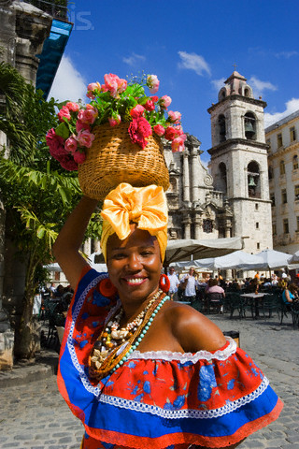
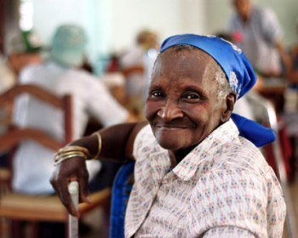
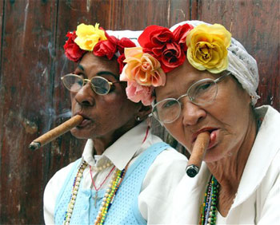

Slide 8
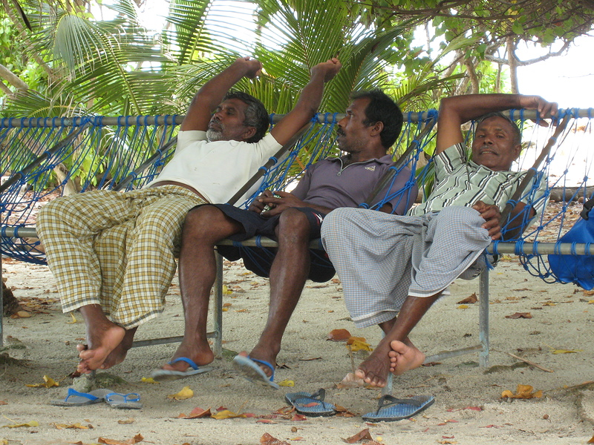
After lunch, Cubans have a siesta. Almost all shops are closed at this time.

Slide 9
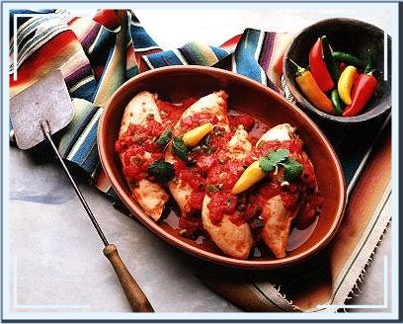
Cuisine
Main ingredients are pork and chicken cooked in various ways. Lobster with lemon, a dish of crocodile or turtle meat, turtle eggs are also worth trying. Cubans always drink very strong and sweet coffee.

Slide 10
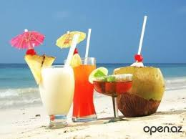
National drinks are Cuban rum and numerous cocktails based on it: Mojito, Cuba Libre, Daiquiri and many others.

Slide 11
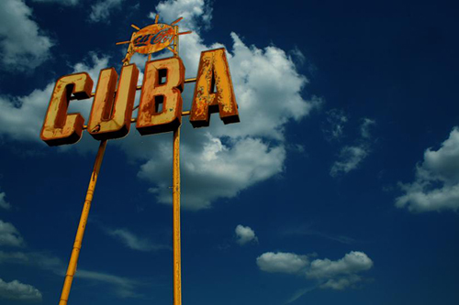
Restaurants and cafes are only situated in big cities like Havana and Santiago de Cuba.

